Slide 1
Twitter sentiment Analysis powered by machine learning
Floyd Askew, Dmitri Dias Fernandes, Nguyen Kim, Robert Pribbenow
Notes:
We are the Big Data group.
We produced a tool for Twitter sentiment analysis Powered by Machine learning
The purpose of the tool is Campaign Response analysis.

Slide 2
Gauging the success of a campaign
Human way
Hire a bunch of people
Set them loose on the internet
They come back with reports on how people
feel about your campaign
Reports are compiled into a dossier
Alternatively
Monitor selected communities
Divide your workforce into groups
Notes:
How could a company currently gauge the success of their marketing campaign?
The human way is to hire a bunch of people:
Have them search the internet for people talking about your campaign
Have their reports compiled into a story or dossier
Alternatively:
Direct their searches to specific sites (instead of the whole web)
Divide your workforce into groups, to avoid redundancy
ROBERT: IF YOU CAN THINK OF SOMETHING ELSE, GO AHEAD AND MENTION IT
Downsides:
Ambitious companies might not have the resources to monitor the reaction to a huge campaign
Your workforce might make bad searches
ROBERT: IF YOU CAN THINK OF SOMETHING ELSE, GO AHEAD AND MENTION IT

Slide 3
Gauging the success of a campaign
Automated way
Have a computer search the web
Have them determine if a message is beneficial towards your campaign
An overview is compiled and reviewed by a person
Benefits
Greater number of comments scanned
Reduced cost of gauging campaigns
Can instead be used to filter the torrent of comments
Notes:
Automated way
Machine does the search
Machine analyses the content of the search
Machine compiles overview, which is verified by a specialist
Benefits
Machines can scan thousands of comments per minute
Machines are cheaper to run
If you distrust a machine doing a full review, it can at least be
used to filter down all the comments, so humans can analyze only
the good or bad ones.
ROBERT: IF YOU CAN THINK OF SOMETHING ELSE, GO AHEAD AND MENTION IT

Slide 4


Machine learning over tweets
Twitter has a big audience
Twitter has an API
Tools already exist to connect to API
AI has made strides in understanding natural language and sentiment analysis
Notes:
The internet is a huge place, so let’s initially narrow it down to Twitter
Twitter has a big audience (around 100 million daily active users)
Twitter has an API, making it unnecessary to scrape through it
There are a few tools already in place to connect to Twitter’s API (Twython, TweePy)
Machine Learning tools have been recently developed for natural language and sentiment analysis
ROBERT: MENTION SOME OTHER AI NATURAL LANGUAGE RESEARCH, IF YOU FIND PERTINENT
Plan: Feed tweets to an AI and have it determine if the tweet is positive or negative towards a topic
Sources:
https://www.omnicoreagency.com/twitter-statistics/

Slide 5
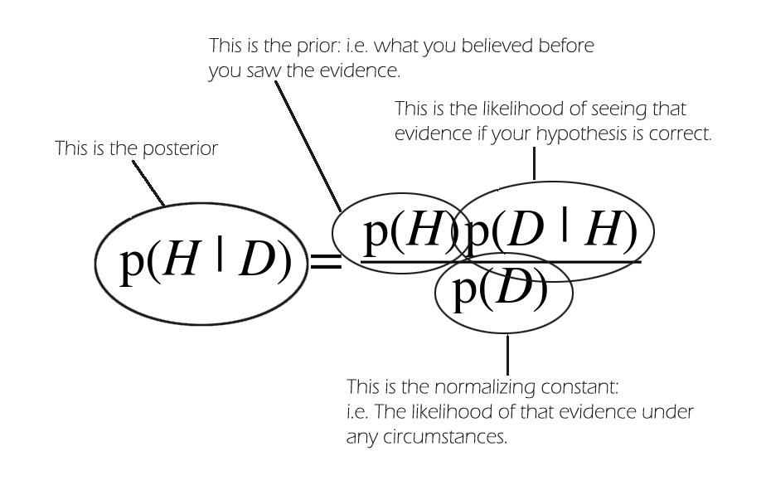
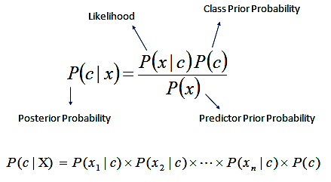
Naive Bayes classifier
Uses independent features represented as vectors
Each word in a sentence is a vector element
Each element is individually judged to be positive, neutral, or negative
The overall leaning of the sentence is then judged
Notes:
Bayes theorem. Probability

Slide 6
Sentiment 140 Dataset
Natural Language ToolKit
1.6 million annotated tweets
Automatically generated from analyzing contained emoji’s
Provided for free to students
Steven Bird, Edward Loper: University of Pennsylvania 2001
Open source tools for natural language processing
Over 50 corpora and lexical resources
text processing libraries for classification, tokenization, stemming, tagging, parsing, and semantic reasoning
Notes:
PART TWO: ANALYSING TWEETS
Step one: Select a annotated dataset and natural language toolkit
ROBERT: BRIEFLY EXPLAIN WHAT YOUR DATASET HAS AND YOUR NATURAL LANGUAGE TOOLKIT
KEEP IT UNDER A MINUTE

Slide 7
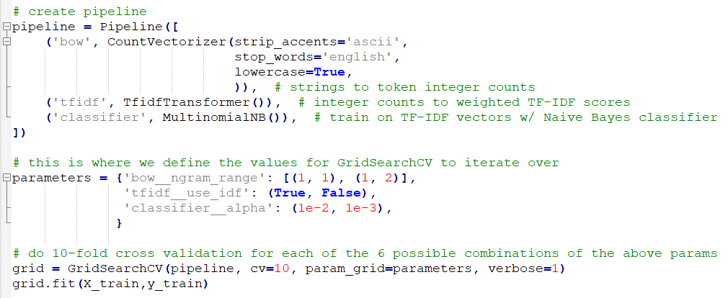
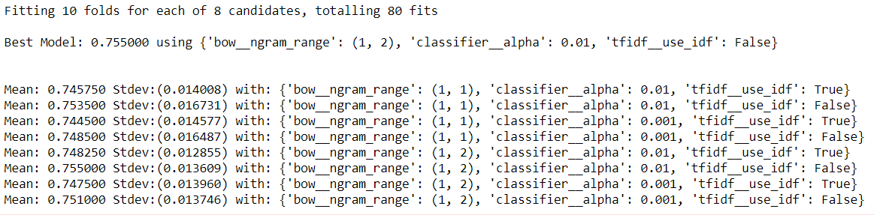
Notes:
Step Three: Model Training
Using the toolkit and the annotated tweet, we train a Machine Learning model
It learns to correlate words with their sentiment
Once it is done learning, if it sees a word again, it’ll remember the sentiment associated with it
It then analyses a sentence and classifies its overall sentiment

Slide 8
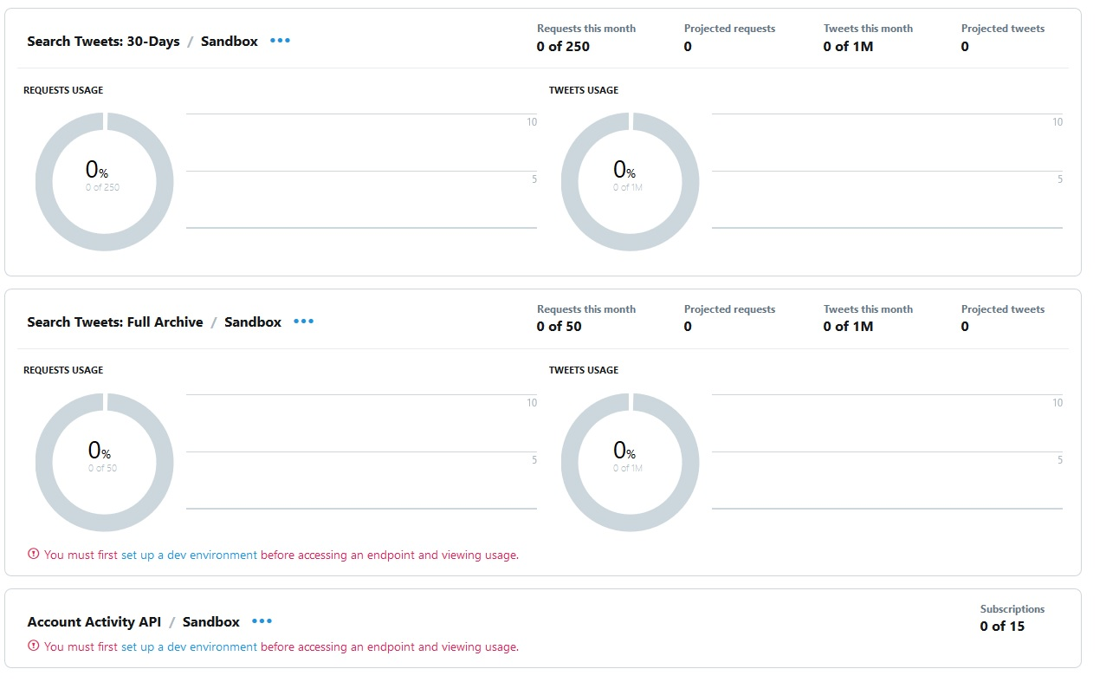
Notes:
PART ONE: PULLING TWEETS
Step one: Set up a Twitter Dev account
Request access to Twitter’s API (recent Twitter requirement, it wasn’t like this a year ago) Our request was approved in two days
The image shows the dashboard, keeping track of your request budget
Twitter limits the number of tweets you can pull per month
This limit could be negotiable for companies

Slide 9
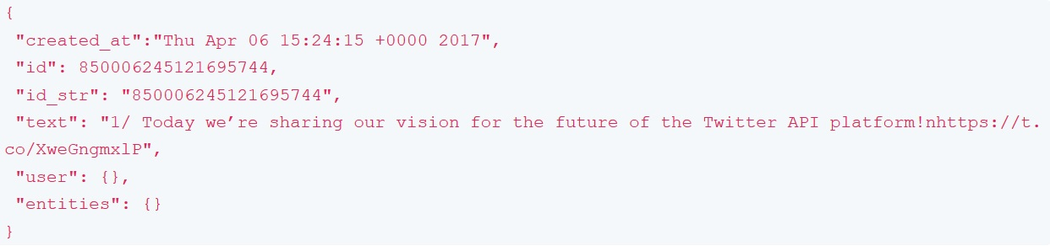
Tweet Object
Notes:
Step two: Find out what parts of a tweet will be useful for you
Tweets are retrieved as “Tweet Objects”, in JSON format
The picture is an example of a tweet object, with a date of creation, ID, and its text
Tweet objects have several fields (not shown).
Who posted the tweet
Where they posted it (on the internet)
Where the tweet came from (in the world)
Who replied to it
What hashtags it has
What media is embedded in it (videos, images)
What language it is in
Etc.
We decided we only needed the tweet’s ID and it’s message, for the purposes of this project.

Slide 10
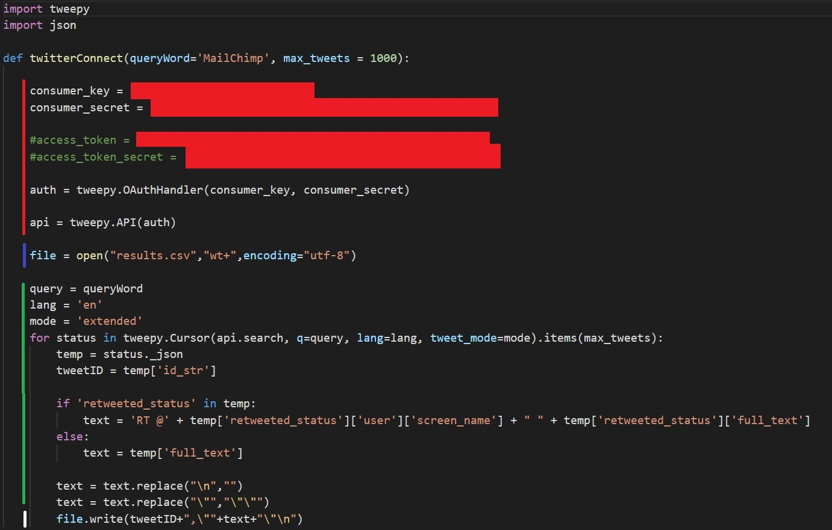
Notes:
Step Three: Pull the actual tweets and format them for the AI
This is our python script to retrieve tweets
Written in python, using Tweepy as the intermediary to connect to Twitter
Twitter’s API uses the same search engine as the one in their website
Using this script and the little search box in Twitter’s site will yield the same results
The lines besides the red bar deal with connecting to twitter using authentication keys
The line besides the blue bar creates the output file for the AI
The lines besides the green file extracts the part of the tweets we want, and format them for the AI
The line besides the white line writes our formatted info to a file

Slide 11
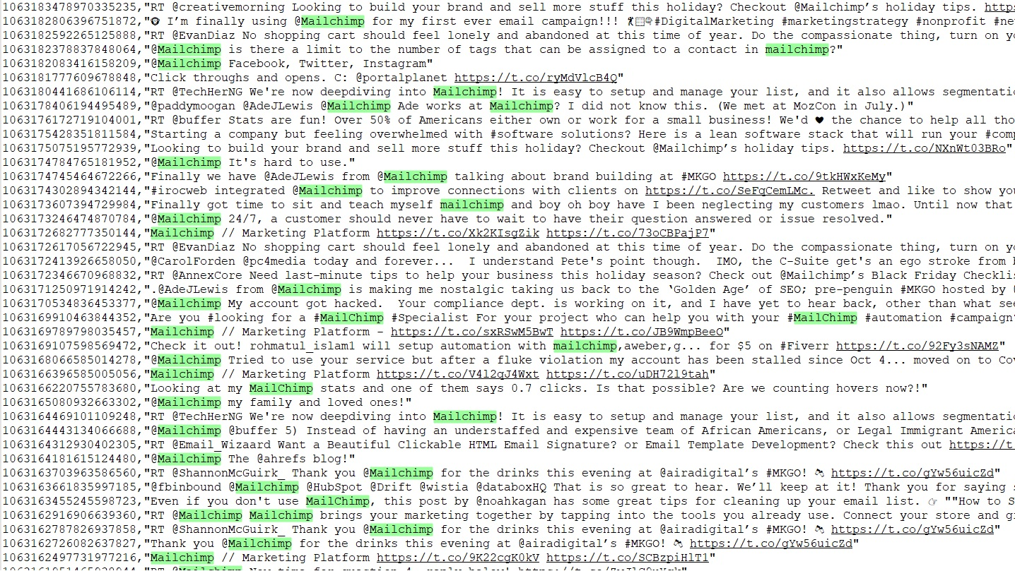
Notes:
This is a selection of 1000 tweets containing the word “Mailchimp”, we grabbed a few weeks ago
Each line contains the tweets ID, followed by the message itself
The JSON object was converted into a CSV file, as a design choice
ROBERT: I THINK YOU SHOULD READ A COUPLE OF POSITIVE TWEETS FROM THIS SLIDE TO HELP WITH THE MOOD
NOTE: We decided on CSV because, at one point, we were thinking about storing tweets in a database

Slide 12
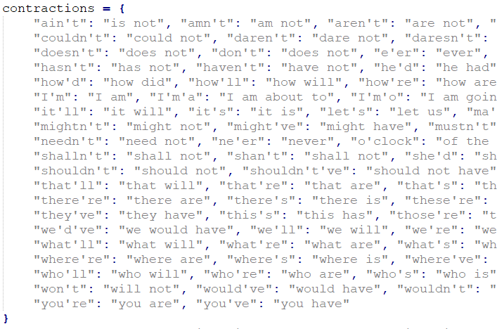
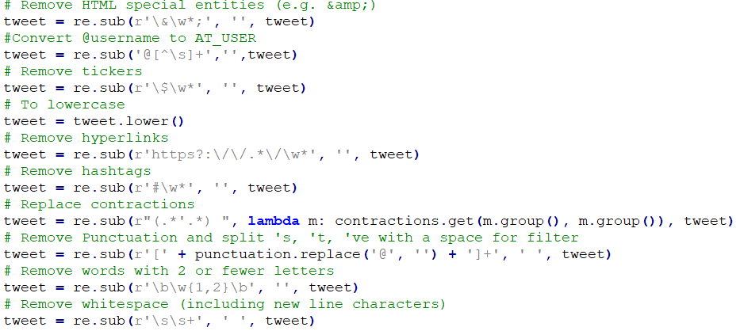
Notes:
Step two: Contraction Removal
The Natural Language Toolkit we selected does not process apostrophes
This could have disastrous consequences (transforming the word “won’t” into “won t”)
We go through the tweet’s text, locate contractions, and revert them to their full word

Slide 13
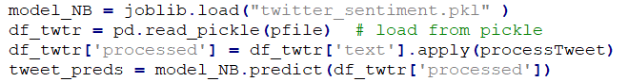
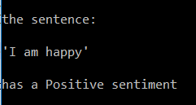
Notes:
Bonus step: Sanity check

Slide 14
Before
1063187315554729986,"I just.... want... mailchimp.... to send.... this goddamn test email ....... to the person.... who has..... to approve it....“
1063182378837848064,"@Mailchimp is there a limit to the number of tags that can be assigned to a contact in mailchimp?“
1063142077167517698,"@David_JWest Thanks, man! I was really impressed with how smooth Mailchimp is."
After
1063187315554729986,"I just.... want... mailchimp.... to send.... this goddamn test email ....... to the person.... who has..... to approve it....",0
1063182378837848064,"@Mailchimp is there a limit to the number of tags that can be assigned to a contact in mailchimp?",2
1063142077167517698,"@David_JWest Thanks, man! I was really impressed with how smooth Mailchimp is.",4
0 = Negative 2 = Neutral 4 = positive
Notes:
Step Four: Analyze tweets using the model
We give the CSV file from earlier to the model, and it outputs another CSV file
This output contains the sentiment of the tweet.
0 for negative, 2 for neutral, 4 for positive

Slide 15
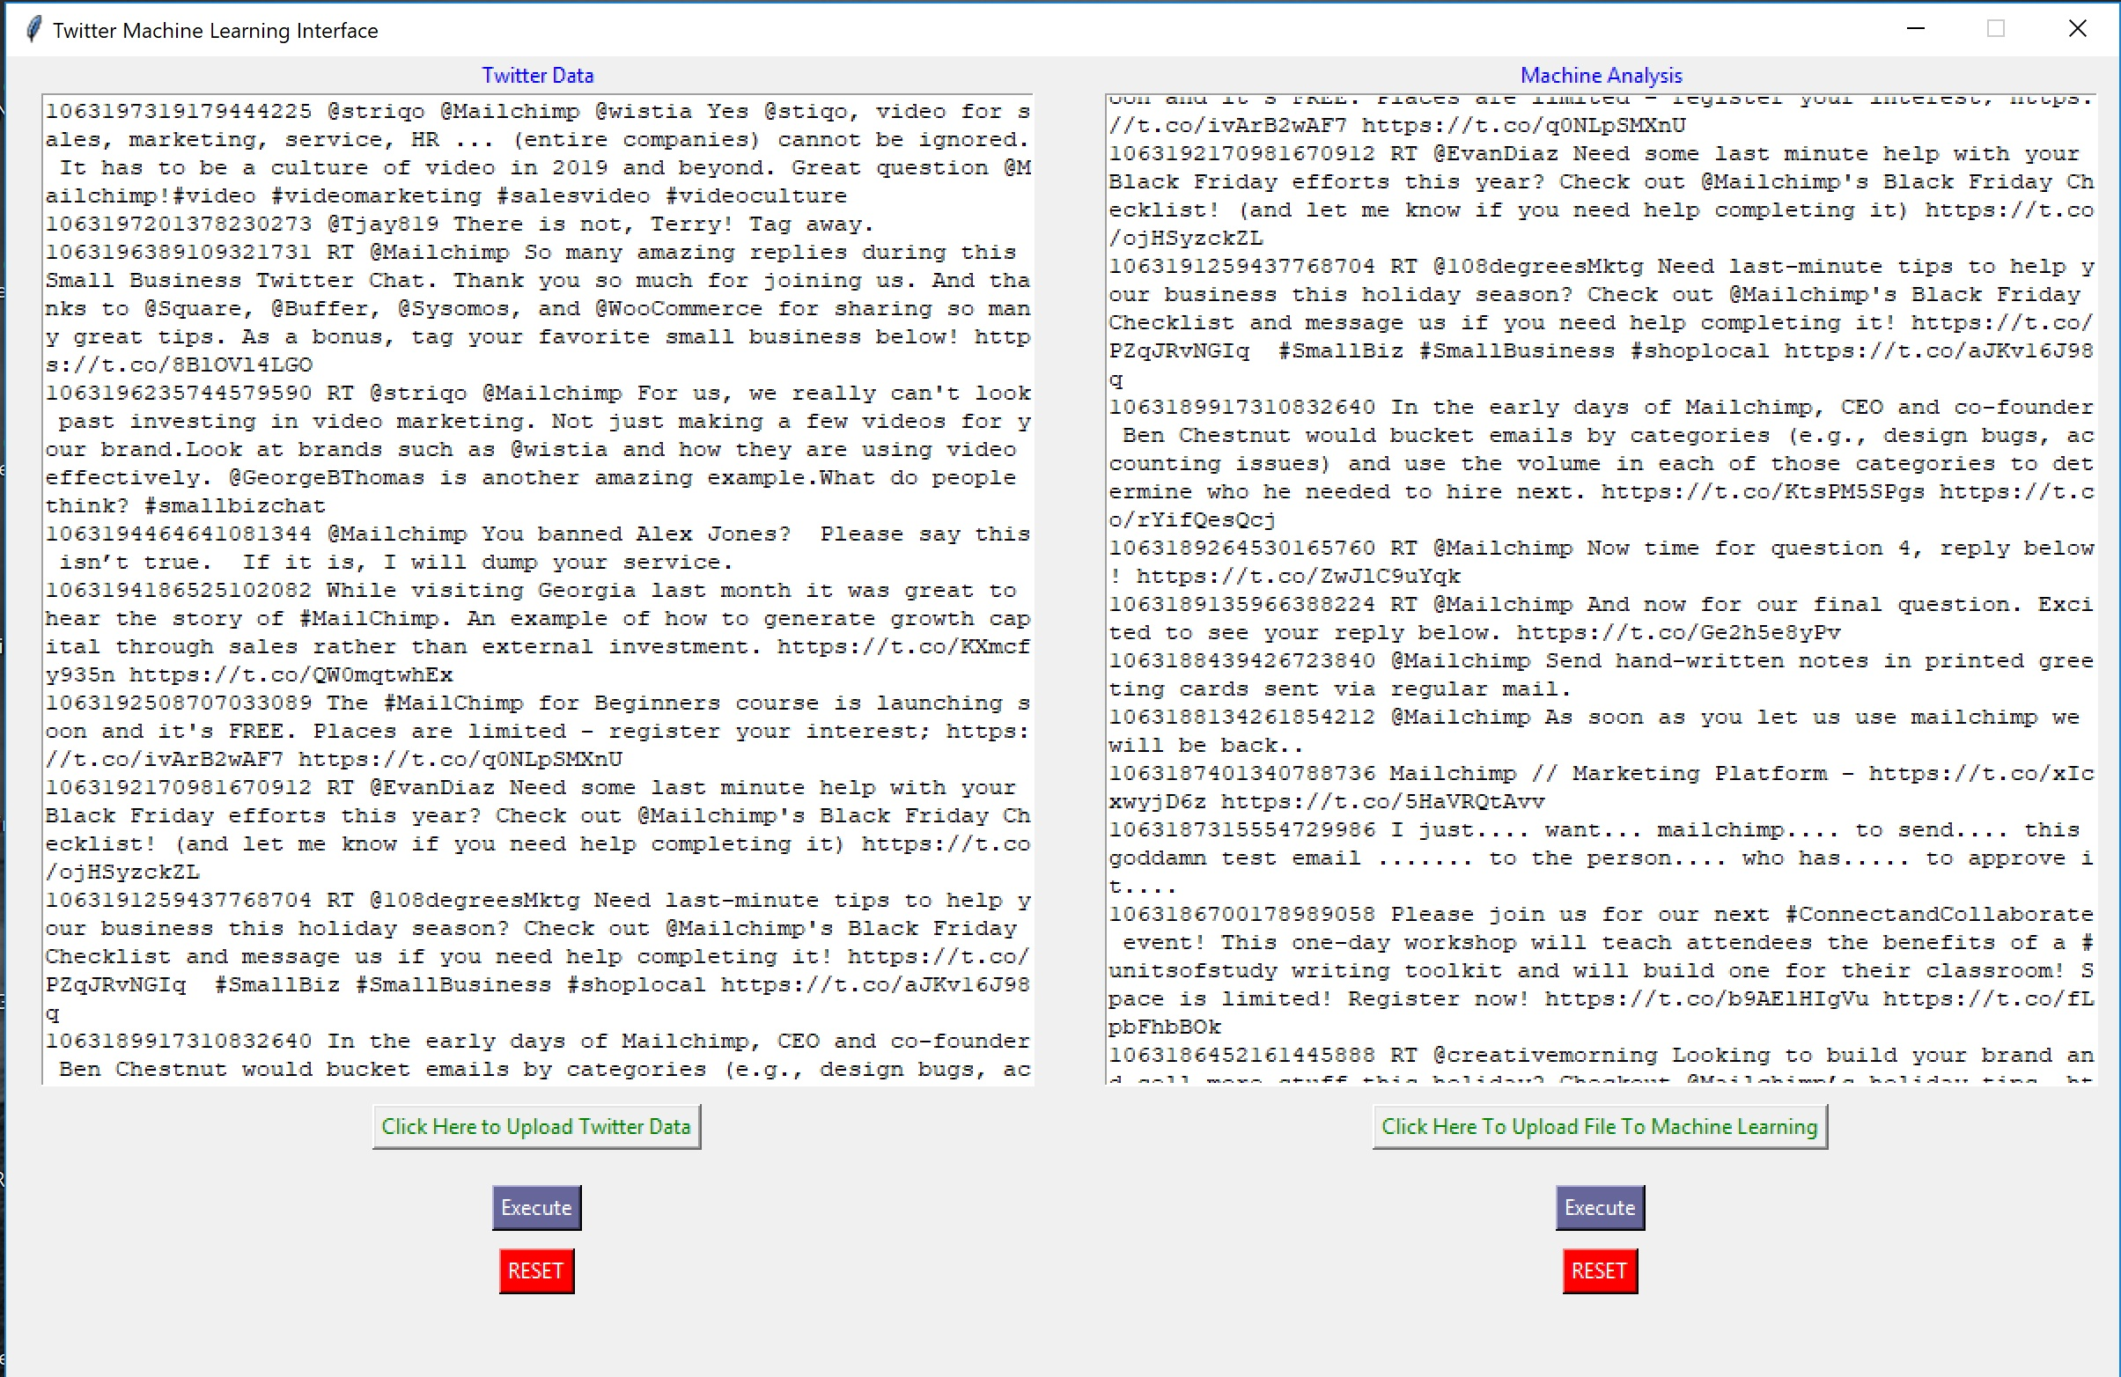
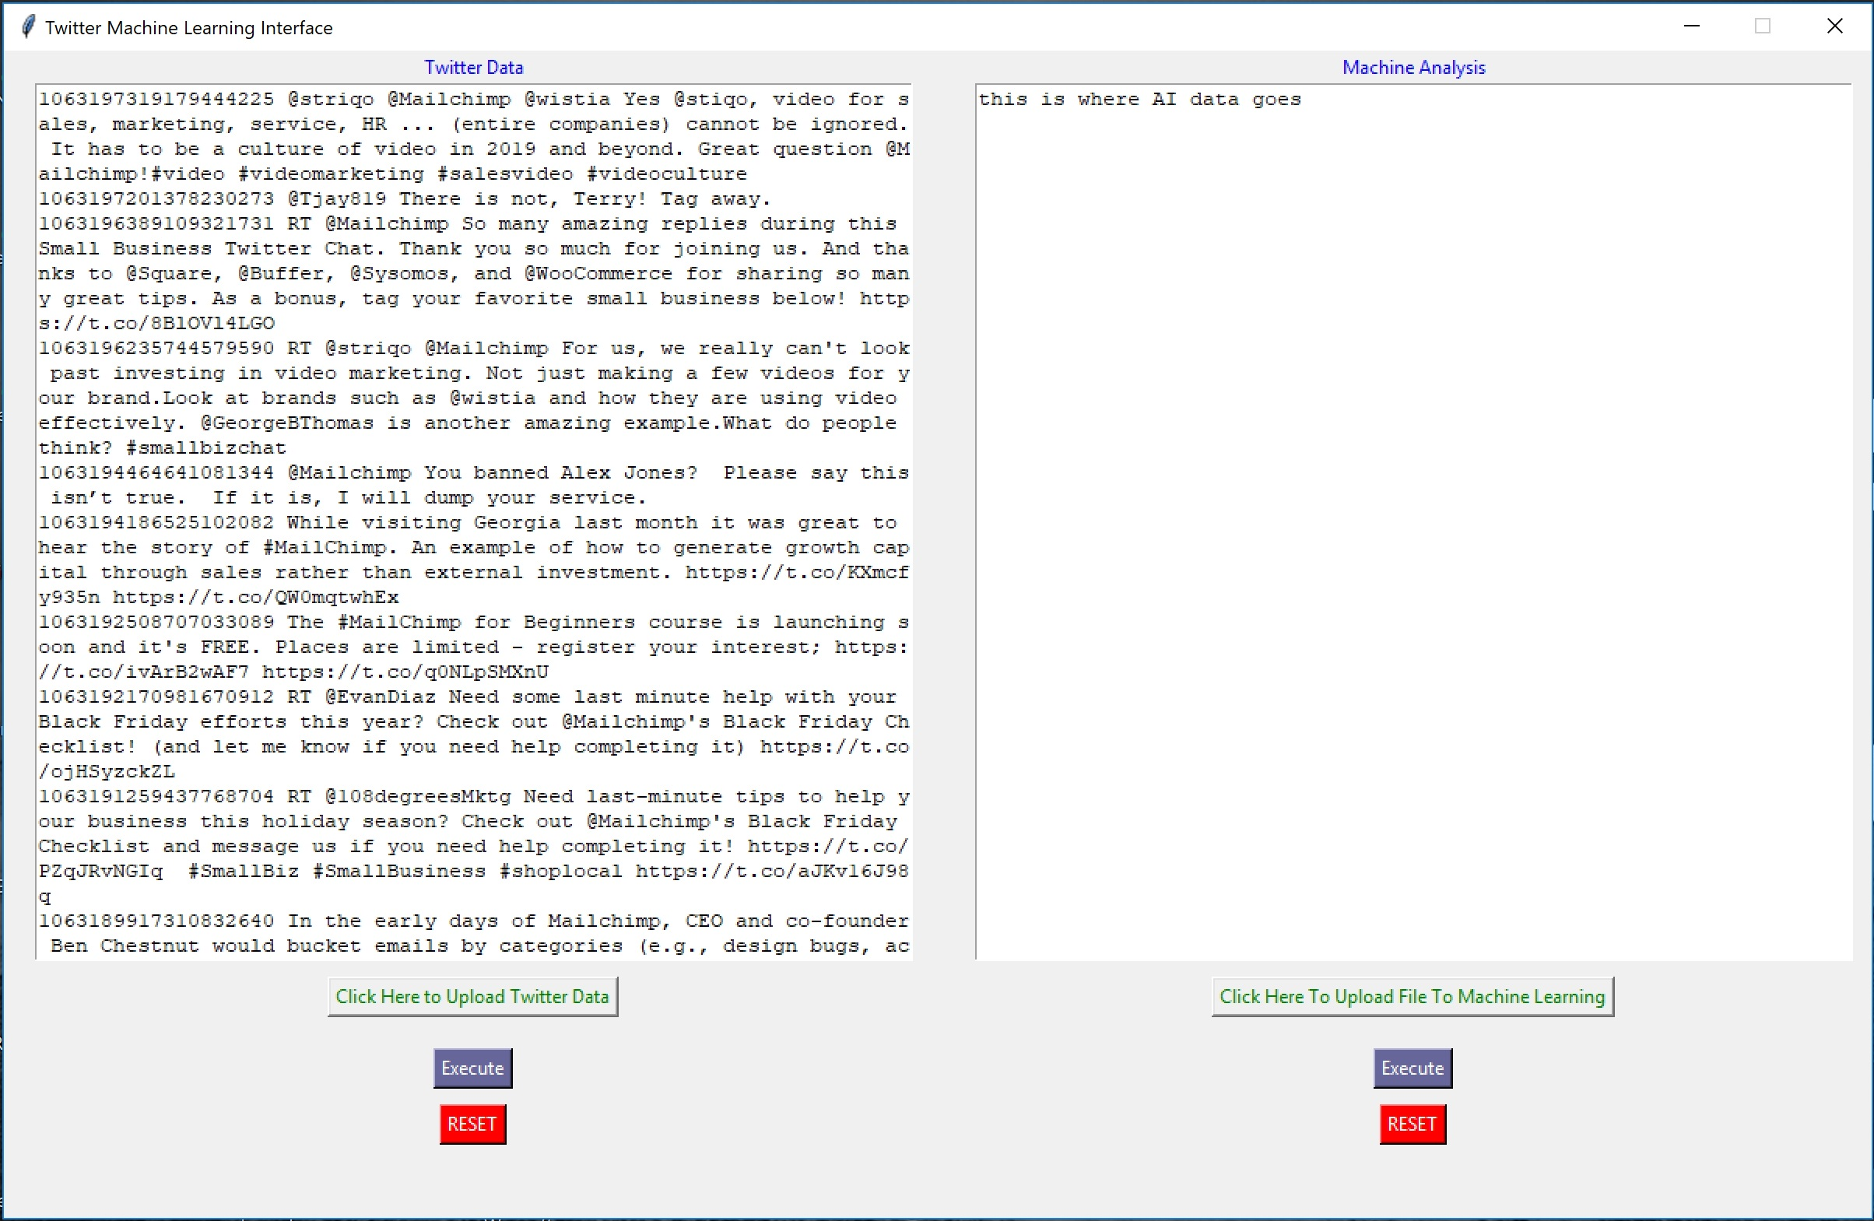
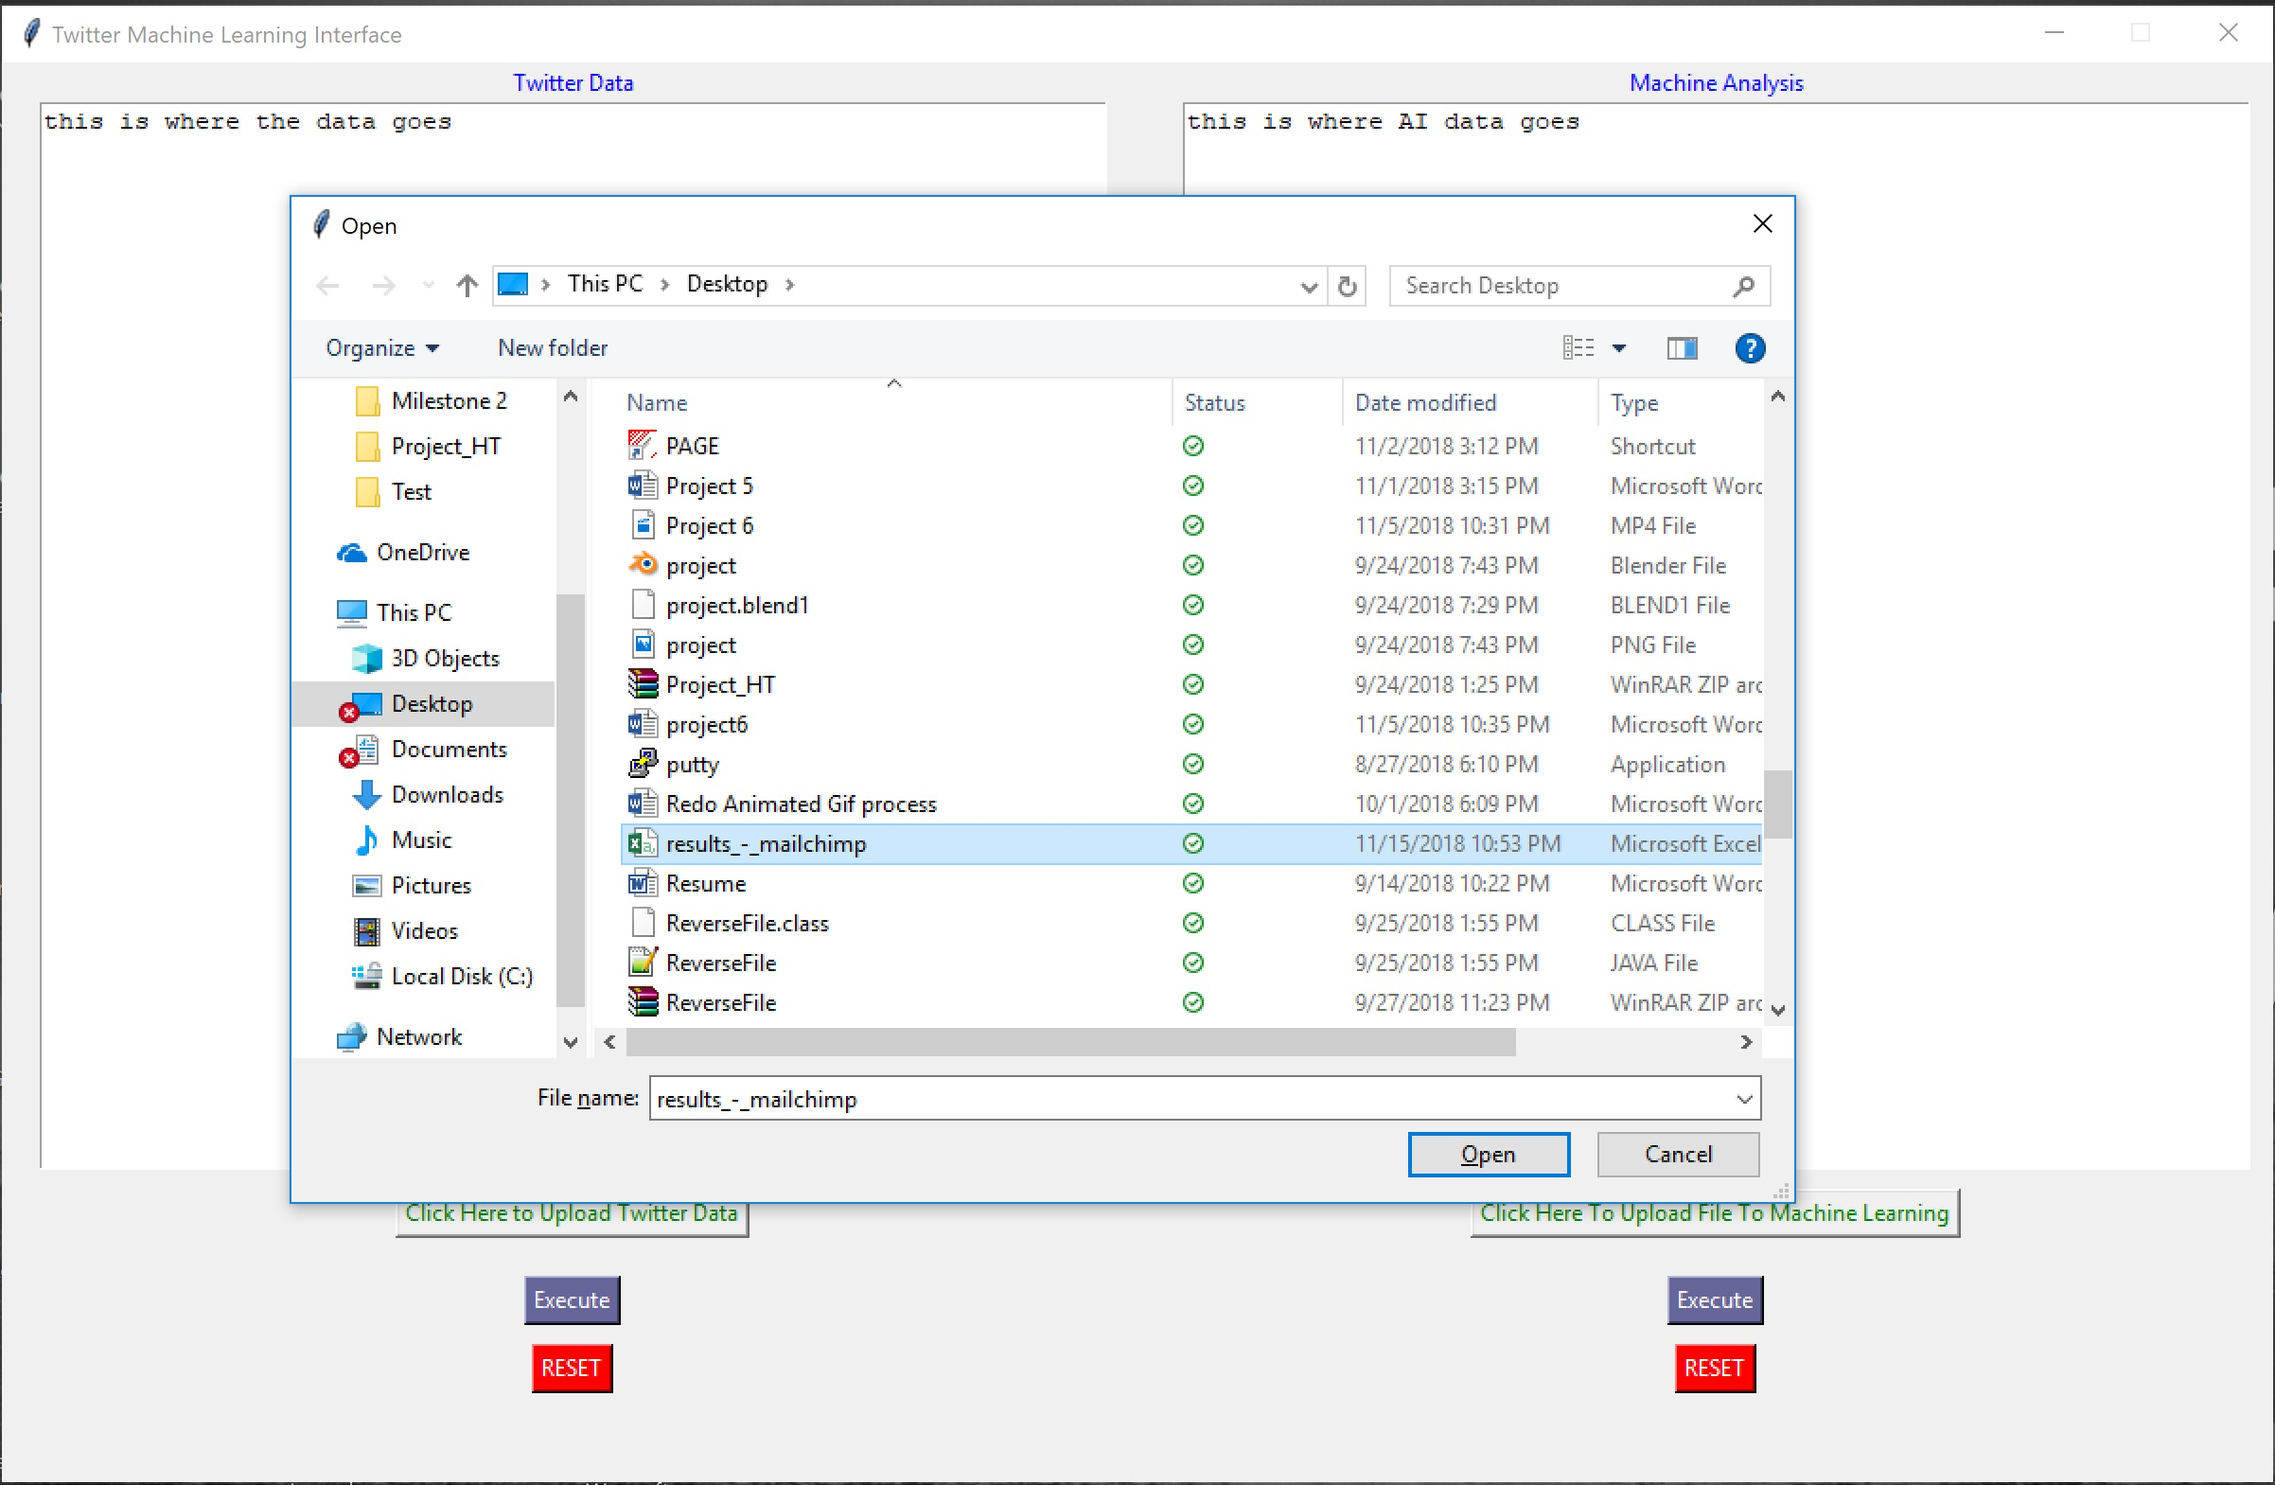
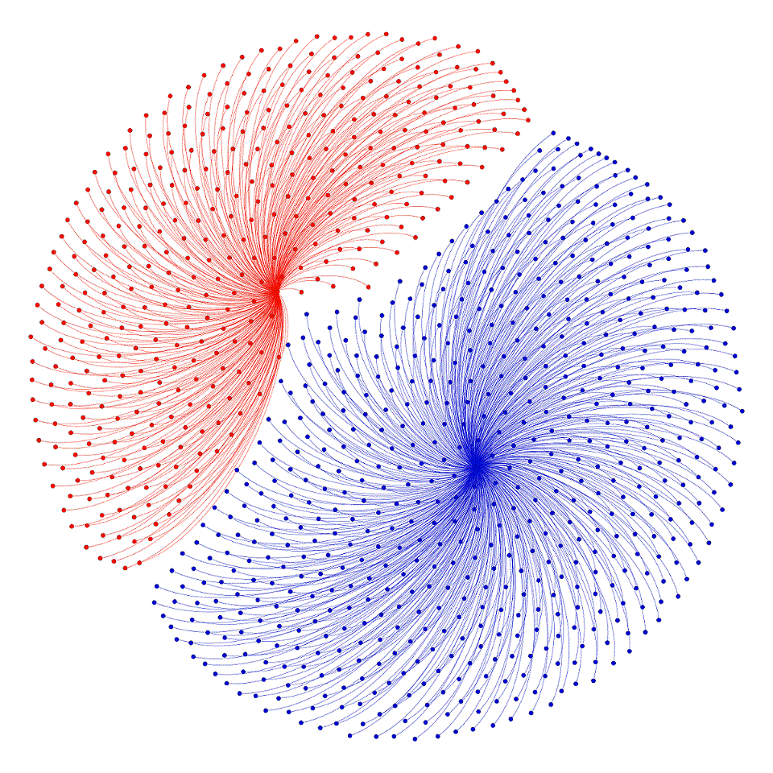
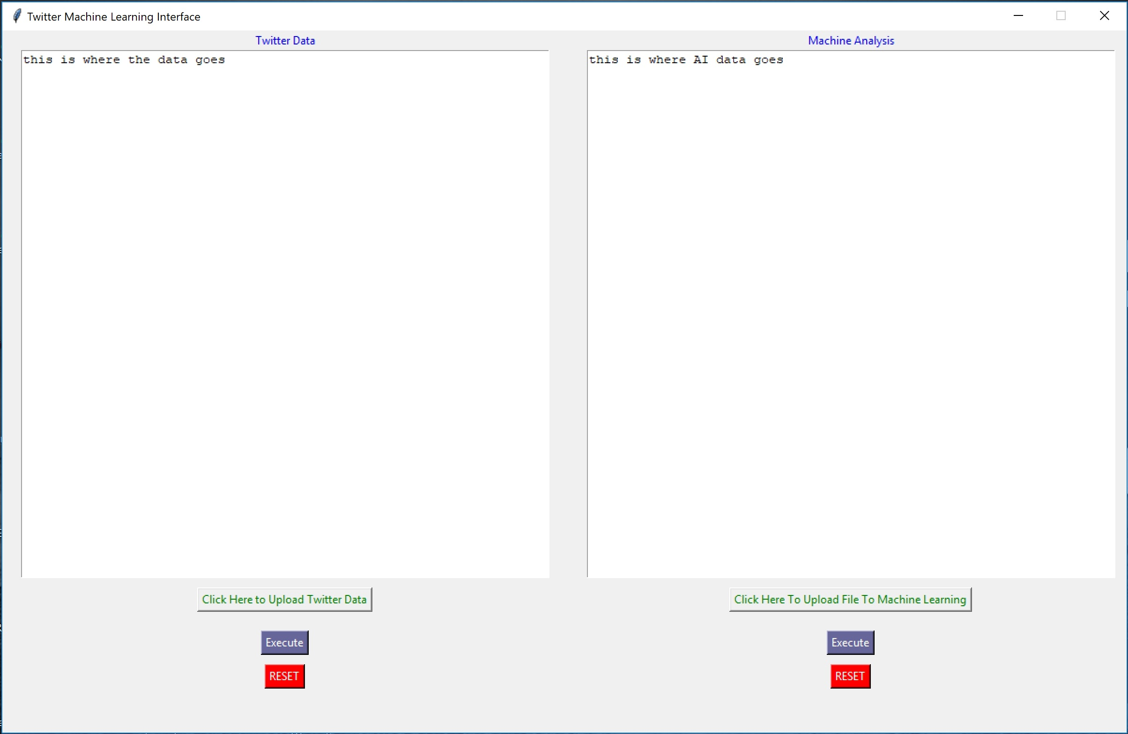
This is how the interface work!

Slide 16
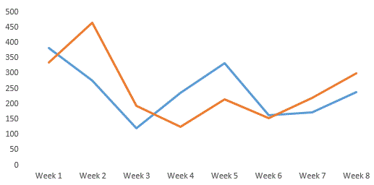
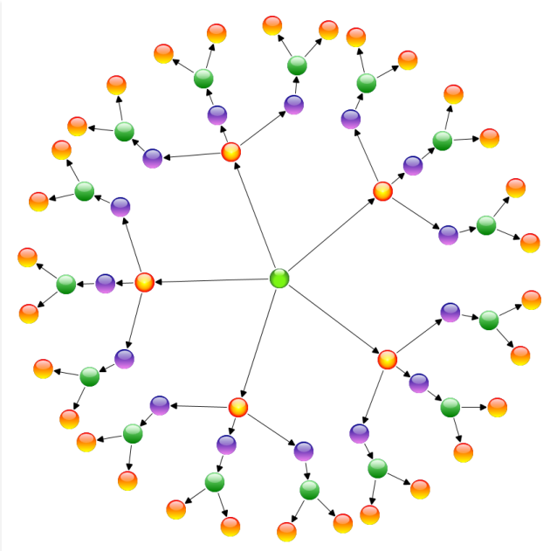
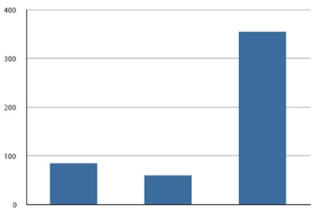
Displaying results
Notes:
PART THREE: VISUAL ANALYTICS
Parse the data into a visual form, for easier consumption
A simple bar graph can show, from all pulled tweets, how many are positive, neutral, or negative
By pulling which date a tweet was posted, a line graph can show positive tweets vs negative tweets, over time
You can do something more fancy, like a node graph
By also pulling which people favorited or replied to a tweet, you can build a web of tweets and sentiments for further insight.
e.g.: Is there much interactivity between people with positive and negative sentiment?
e.g.: Is there an “influencer” at the center of a positive or negative sentiment web?
In this part, your imagination is the limit.
IF WE ARE DOING A LIVE PRESENTATION WITH OUR RESULTS, THIS WOULD BE THE TIME FOR IT

Slide 17
Future Plans
Expand on the model.
Research Ensemble Models, using multiple complimentary algorithms to get more accurate predictions.
Automate execution
Notes:
FROM YOUR SLIDES, ROBERT

Slide 18
THANK YOU FOR YOUR ATTENTION
Questions?
Comments?
Suggestions?

